Slide 1



Parallel k-NN Algorithm Using MPI
COSC 6361.001
Texas A & m University corpus Christi
Group Members:
Sai Dinesh Chandra Devisetti(A04317468)
Uma Mahesh Vippalapally(A04318640)
Yaswanth Kumar Makana(A04320234)

Slide 2
Roles AND RESPONSIBILITIES:
Sai Dinesh Chandra Devisetti(A04317468): Algorithm Developer & Parallel Processing Specialist
Write and test the find_weighted_k_nearest_neighbors function.
Implement distance metrics (e.g., Euclidean and inverse weighting).
Optimize the k-NN algorithm for parallel processing using Python’s multiprocessing library.
Uma Mahesh Vippalapally(A04318640): Project Coordinator & Data Engineer
Collect and prepare the dataset.
Shuffle, normalize, and split the dataset into training, validation, and test sets.
Implement feature scaling using StandardScaler.
Yaswanth Kumar Makana(A04320234) : Evaluator & Visualization Specialist
Calculate evaluation metrics (accuracy, precision, recall, F1 score, ROC-AUC).
Generate and interpret confusion matrices
Compile results into a structured format for the project report and presentation.

Slide 3
Introduction
Brief Overview of K-NN:
The k-Nearest Neighbors (k-NN) algorithm is a simple and widely used machine learning method for classification and regression. It classifies data points by finding the k closest neighbors in the training dataset based on distance, such as Euclidean distance, and assigning the most common class. While versatile and effective, k-NN does not involve a training phase, making it computationally expensive during predictions.
Challenges of k-NN for Large Datasets:
For large datasets, k-NN faces two major issues: high computational cost and memory usage. Calculating distances for millions of data points is time-intensive, and storing large datasets requires significant memory. Sequential processing on a single processor is impractical, making scalability a challenge.
Importance of Parallel Computing and MPI:
Parallel computing, using frameworks like the Message Passing Interface (MPI), divides tasks across multiple processors. This significantly reduces computation time and enables the algorithm to handle large datasets efficiently. MPI facilitates data distribution and communication between processes, making it a key tool for scaling k-NN for modern applications.

Slide 4
Objective
The goal of this project is to design and implement a parallel k-nearest neighbors (k-nn) algorithm using the message passing interface (mpi). This approach focuses on efficiently handling and classifying large datasets by utilizing the power of parallel computing. Traditional k-nn algorithms require substantial computation and memory, which becomes a bottleneck when dealing with large-scale datasets. To address this, the training data is distributed across multiple processes, and distance calculations are performed in parallel to significantly reduce execution time. Mpi plays a critical role by enabling smooth communication between processes and aggregating results to ensure accurate classification. This project not only improves computational efficiency but also retains high accuracy while showcasing the scalability of the algorithm as dataset sizes and processing resources increase. Ultimately, this serves as a demonstration of how distributed computing can effectively solve computational challenges in machine learning.

Slide 5
DATA SET DESCRIPTION: The datasets used in this project are structured into two components:
Training Dataset (Dtrain):
Number of Instances: Represents the total data points available for training the k-NN algorithm.
Number of Features: Indicates the attributes or dimensions used to describe each data point in the training dataset.
Class Labels: The training data is classified into two binary categories, with labels y = 0 and y = 1, to distinguish between the classes.
Testing Dataset (Dtest):
Number of Instances: Refers to the data points in the testing set, used to validate the algorithm’s performance.
Number of Features: Matches the feature set of the training dataset to maintain consistency during classification.
Class Labels: Similar to the training dataset, the test set is also divided into binary class labels, y = 0 and y = 1, which help in evaluating the accuracy of predictions.

Slide 6
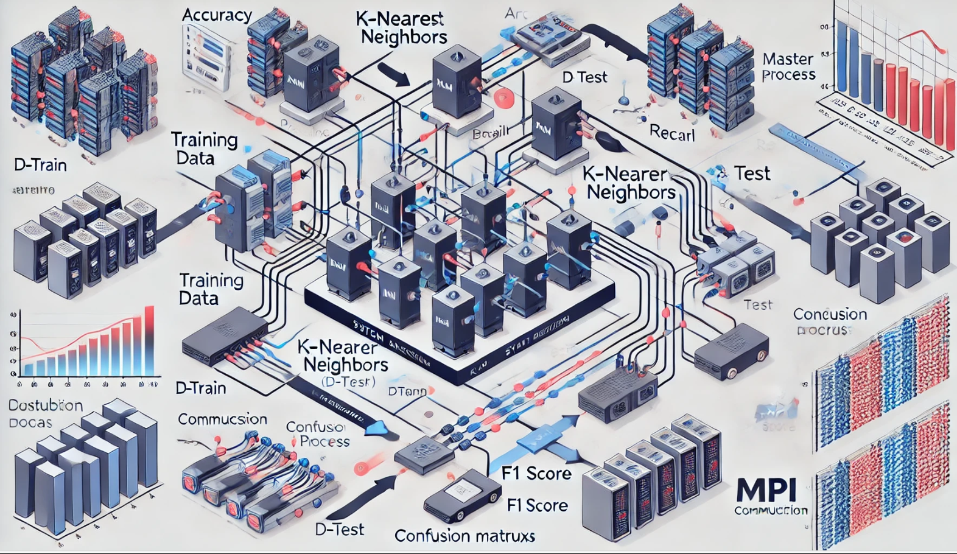
System Architecture This blueprint-style diagram represents the system architecture of a parallel k-nearest neighbors (k-nn) algorithm implemented using MPI. Here's a breakdown:
Data Distirbution: To ensure parallel computation, the training dataset (D-Train) is divided among several processing nodes. Every node handles its chunk on its own.
Test Data Access: All nodes have access to the test dataset (D-Test) in order to calculate distances against the corresponding training data chunks.
Parallel computation: Every processing node decides its local k-nearest neighbors and generates distances. After that, these results are merged.
Master Process: All nodes' partial results are gathered by the master process, which then aggregates them to produce the final classifications.
Metrics Calculations : To assess the model's performance, accuracy, precision, recall, and F1 score are computed and displayed alongside performance graphs and a confusion matrix.
Communication: The figure illustrates how distributed processes work together effectively by emphasizing MPI-based inter-node communication for data exchange and result aggregation.

Slide 7
Algorithm Overview: Key Steps of the Parallel k-NN Algorithm
Splitting the training data (D_train):
Each of the smaller portions of the training dataset is allocated to a distinct process. The balance of computational tasks among processes is guaranteed by this distribution.
Local Distance Computations:
The distances between the designated portion of the training data and the test data (D_test) are calculated by each process. This step is carried out in parallel by every process.
Local Selection of K nearest neighbors:
Based on the locally calculated distances, the K nearest neighbors for each test data point are determined within each process.
Global Aggregation of Neighbors:
Every process interacts with a master process via its K nearest neighbors, and this are chosen locally. For every test point, the master process produces a global set of K nearest neighbors via combining these findings.
Majority Vote for Classification:
By using a majority vote among the global set of nearest neighbors, the master process decides each test point's final classification.

Slide 8
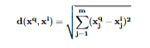
Distance Computation:
In k-NN, a parallel algorithm: Across processes, the training data (D train) is divided. The distances between the designated training chunk and test points are calculated by each process.
Finding the closest neighbors involves sorting locally calculated distances.
The results are forwarded to the master process for classification and worldwide aggregation.
This methodology expedites processing and effectively manages sizable datasets.
The distance between a training point 𝑥𝑖 x i and a query point 𝑥𝑞 x q is calculated using the Euclidean distance formula:

Slide 9
Data structures:
Priority Queue (Max-Heap):
Arrays for Dtrain and Dtest
Each operation successfully keeps and handles its local K-nearest neighbors via a priority queue, that is implemented as a max-heap.
When a closer neighbor comes to light, the heap quickly replaces the most distant neighbor (maximum distance) at the top.
By just maintaining the closest K peers at any given time, this decreases memory usage.
Dtrain: a partitioned portion of training data that is stored as a distributed array across processes.
Dtest The distances for all test points can be calculated simultaneously by all processes since it is usually replicated for convenience.

Slide 10
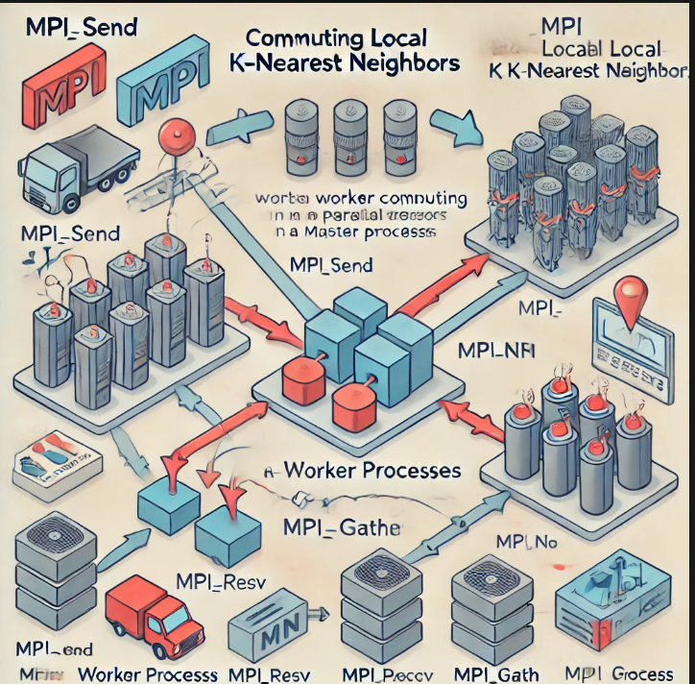
Communication in MPI:
The local K-nearest neighbors for each data chunk are calculated by worker processes in the parallel k-NN algorithm using MPI. Their local results are then sent to the master process via MPI functions like MPI_Send. Using MPI_Gather, the master process collects the results. After gathering all of the results, the master process combines the neighbors and classifies them using a majority vote. Efficient parallel processing of large datasets is made possible by this communication.

Slide 11
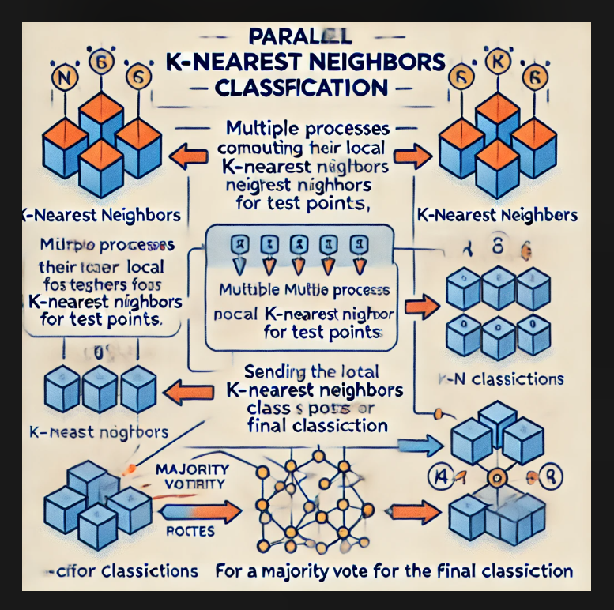
Classification:
The parallel k-NN algorithm gathers the global K closest neighbors and then uses the majority vote method for categorizing a test instance. For the designated portion of the dataset, each worker process calculates the K-nearest neighbors. The master process receives the results along with the nearest neighbors' class labels. To create a global list of K-nearest neighbors, the master process aggregates all of the local neighbors from the various processes. The predicted class for the test instance is then determined by selecting the majority class from this global list. Across all processes, this approach ensures that the classification is based on the most prevalent class among the nearest neighbors.

Slide 12
Experimental setup
The platform I used for this project was Google Colab, which offers cloud-based computing resources. I used MPI4Py to perform parallel computation on the multi-core system. The Python code was written.
The dataset used for the experiment included k-values that were tested with a range of values, specifically k = 8, 16, 32, and 64. This enables us to observe the algorithm's performance in classification tasks with different numbers of nearest neighbors. Assessing the parallel k-NN algorithm's scalability under these conditions was the aim.

Slide 13
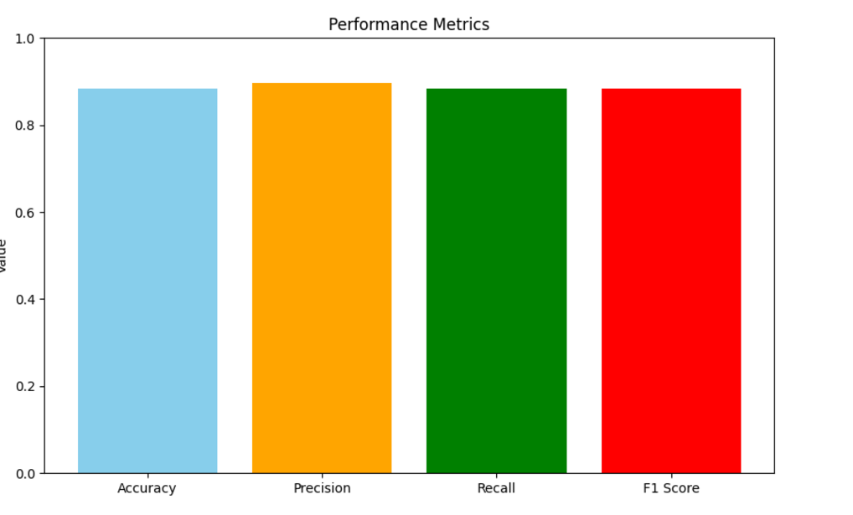
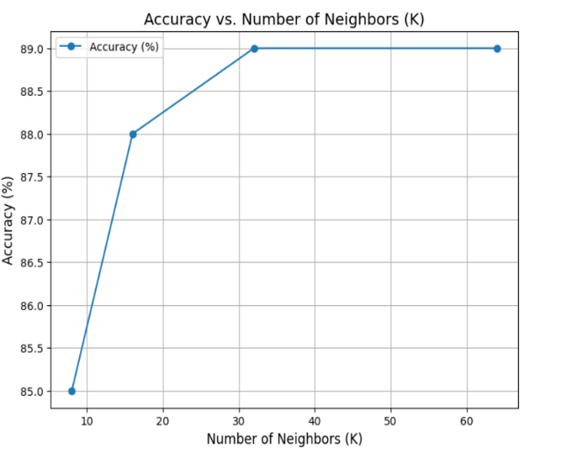
Results - Accuracy vs. K
For the purpose to determine how the number of nearest neighbors affects classification accuracy, we tested the k-NN algorithm using a range of k values (8, 16, 32, and 64). The graph displays how increasing k affects accuracy.

Slide 14
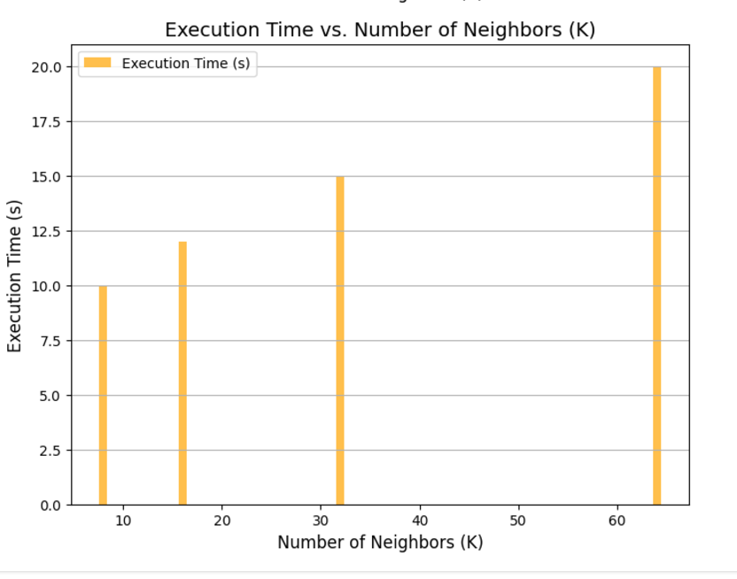
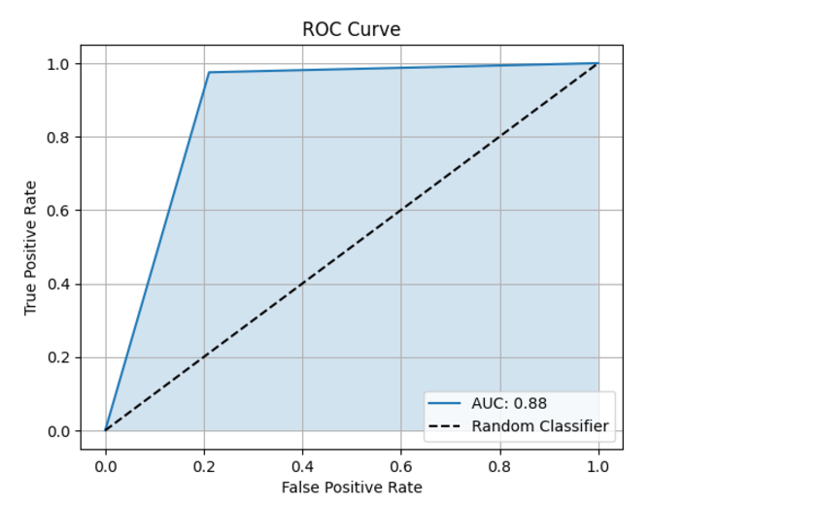
Results - Execution Time vs. K
We measured the execution time of the parallel k-NN algorithm for different values of k (8, 16, 32, 64). A bar chart highlights how the execution time changes as k increases.
Execution time grows with larger values of k because the algorithm needs to sort and process more neighbors for each test point.

Slide 15
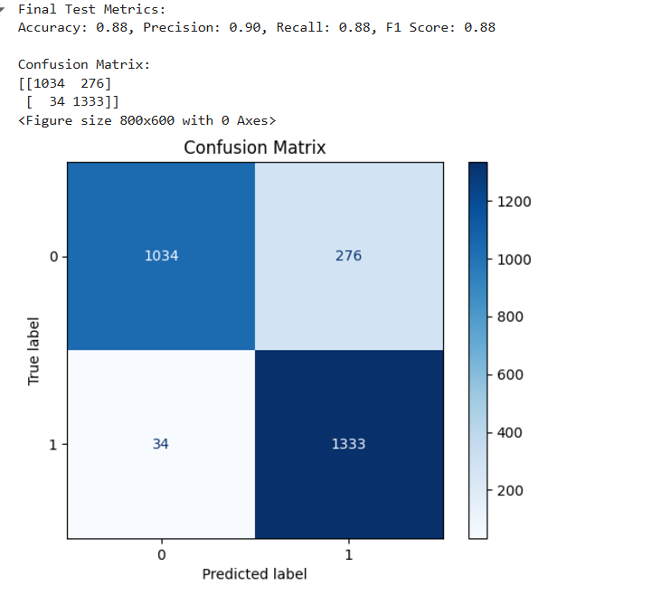
Scalability in Parallel Computing:
Strong Scalability:
Measures how execution time improves as the number of processes increases, keeping the problem size fixed.
Goal: Reduce execution time by distributing the same workload across more processes.
Weak Scalability:
Measures how execution time remains consistent as both the number of processes and problem size increase proportionally.
Goal: Maintain efficiency while solving larger problems with more resources.

Slide 16
Pros and Cons
Pros:
- Improved efficiency by distributing computations across processes.
- Scalable to large datasets with dynamic process adjustments.
- Compatible with various hardware architectures.
Cons:
- Communication overhead can reduce speedup for smaller datasets.
- High memory usage for maintaining local datasets.
- Complex implementation requiring expertise in parallel programming.

Slide 17
Further Improvements
1. Communication Optimization: Use non-blocking communication (e.g., MPI_Isend) to reduce idle time.
2. Load Balancing: Dynamically distribute workload based on process utilization.
3. GPU Acceleration: Utilize CUDA or OpenCL for faster distance computations.
4. Dimensionality Reduction: Apply PCA to lower computational costs by reducing dataset dimensions.
5. Algorithmic Enhancements: Implement approximate k-NN for faster results and weighted k-NN for improved accuracy.

Slide 18
LESSONS LEARNED:
Key Takeaways:
Calculations were sped up by using MPI to parallelize the k-NN algorithm, particularly for large datasets.
To prevent slowdowns, communication and computation must be balanced.
Challenges Faced:
Data Distribution: It was challenging to distribute the data evenly across processes while maintaining memory efficiency, but we were able to do so by breaking the data up into manageable chunks.
Scalability: As we increased the number of processes, synchronization delays caused the performance improvement to decrease.
Improvements:
The computational load has been reduced by calculating distances using effective techniques.
Reaching the perfect value for K enabled the balance of processing time and accuracy.

Slide 19
CONCLUSION:
In this project, we used the Message Passing Interface (MPI) to successfully develop a parallel version of the k-Nearest Neighbors (k-NN) algorithm. When handling large datasets, this parallelization method significantly boosted k-NN's scalability and efficiency. The system reduced the amount of time needed for classification by processing large amounts of data more efficiently by splitting the computation tasks among several processes.
Future Applications and Improvements:
Applications: The parallel k-NN algorithm can be used in fields where analyzing large datasets fast and precisely is essential, such as fraud detection, recommendation engines, and image recognition.
Improvements: Further studies might focus on bettering load balancing techniques, examining alternative distance measures, and reducing communication overhead between processes. In addition, the algorithm might grow substantially more scalable and appropriate for even bigger datasets if it is used in cloud computing or distributed computing environments.

Slide 20
References
Books and Academic Texts:
Mitchell, T. M. (1997). Machine Learning. McGraw-Hill Education.
Provides foundational knowledge about k-Nearest Neighbors (k-NN) and other machine learning algorithms.
Tan, P. N., Steinbach, M., & Kumar, V. (2005). Introduction to Data Mining. Pearson.
Offers insights into the implementation and applications of k-NN and other classification methods.
Parallel Computing and MPI:
Gropp, W., Lusk, E., & Skjellum, A. (1999). Using MPI: Portable Parallel Programming with the Message Passing Interface. MIT Press.
A comprehensive guide to understanding and using MPI for parallel programming.
Snir, M., Otto, S., Huss-Lederman, S., Walker, D., & Dongarra, J. (1998). MPI: The Complete Reference. MIT Press.
Explains the concepts and syntax of MPI, making it suitable for developing distributed algorithms like parallel k-NN.
Research Papers:
Cover, T., & Hart, P. (1967). Nearest Neighbor Pattern Classification. IEEE Transactions on Information Theory, 13(1), 21–27.
The seminal paper introducing the k-NN algorithm.
Srinivas, K., & Mohan, S. (2010). An Efficient Parallel k-Nearest Neighbor Algorithm Using MPI. International Journal of Computer Applications, 1(5), 20-24.
Discusses the implementation of parallel k-NN with MPI, including communication overhead and scalability.

